Slide 1

Chapter 15:
Task Models
Analyzing how people perform real-world tasks to inform interactive system design & interaction architectures.
Human-Computer Interaction (3rd Ed.)
Dix, Finlay, Abowd, Beale

Slide 2
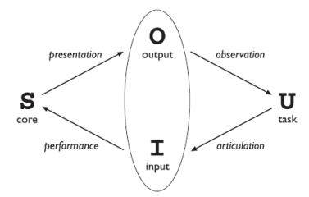
What is Task Analysis?
Understanding Human Work
Task Analysis is the structured process of studying how people perform jobs—identifying the actions they take, the tools they interact with, and the knowledge required.
What people do: Workflows, subtask sequences, and execution steps.
What things they work with: Physical/digital artifacts, controls, and environmental objects.
What they must know: Domain concepts, operational rules, and procedural frameworks.

Slide 3






Three Core Types (Sequentially)
Task Decomposition (Hierarchy Task Analysis)
Knowledge-Based Task Analysis
Entity/Object-Based Analysis
Focuses on what the user knows about the task domain and how that knowledge is structured logically (e.g., Task Description Hierarchy / TDH).
Analyzes relationships between actors, objects, actions, and events in the task environment (e.g., Entity-Relationship techniques).
Breaks high-level goals into an ordered hierarchy of subtasks and execution plans (e.g., UNIPLEX automation menu/task hierarchy).

Slide 4

Task Analysis vs. Other Techniques
Technique Pair | Primary Focus | Secondary Focus | HCI Key Distinction
Systems Analysis vs. Task Analysis | System architecture & software data flow | The human user & real-world tasks | Task Analysis centers on user goals rather than system processing limits.
Cognitive Models vs. Task Analysis | Internal mental states & cognitive load | External observable actions & full jobs | Task Analysis focuses on complete real-world jobs, not just unit mental tasks.

Slide 5
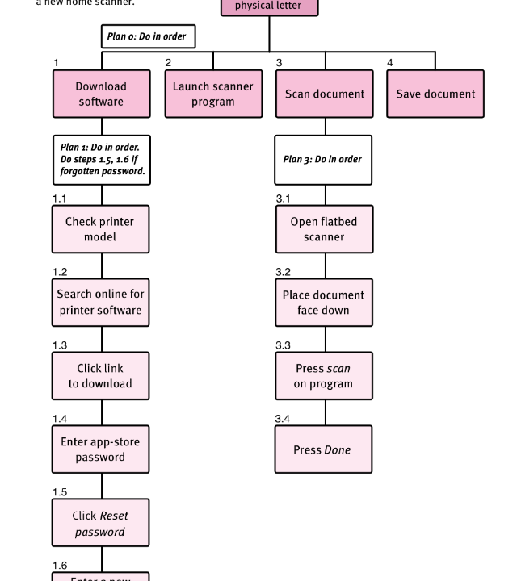
1. Task Decomposition (HTA)
HTA & Office Application
Decomposes a main goal into ordered subtasks alongside explicit Plans describing execution conditions.
Key Principles:
• Office Application Model: Deconstructs complex workflows into hierarchical sub-menus and command tasks.
• Execution Plans: Specify fixed, optional, or discretionary subtask sequences.

Slide 6
HTA Parsing Example: Cleaning House
0. In order to clean the house: Main high-level goal statement.
1. Get vacuum cleaner out & 2. Get appropriate attachment: Sequential preparation subtasks (Plan 0).
3. Clean rooms: Decomposed further into 3.1 Hallway, 3.2 Living room, 3.3 Bedrooms (Plan 3: Discretionary order).
4. Empty dust bag & 5. Put vacuum away: Event-driven interrupt task when full, followed by storage task.

Slide 7
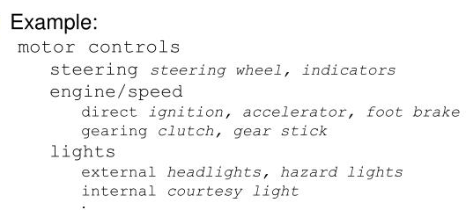
2. Knowledge-Based Analysis
Specialized information and concepts a user needs to know to complete a job, rather than just tracking physical steps.
Core Concepts
  Focus on Domains: It looks at the objects, actions, and relationships involved in a task domain instead of strict procedural order.
  Taxonomies: It builds hierarchies or categorization maps of what information a person must understand.
  Knowledge Requirements: It identifies prerequisite facts, terminology, and concepts necessary for expert performance.

Slide 8
3. Entity/Object-Based Analysis
Example: Online Shopping 🛒
Entities/Objects: User, Product, Shopping Cart, Payment, Order
User Actions: Search Product → Select Product → Add to Cart → Checkout → Make Payment → Place Order
Relationships:
  User selects a Product
  Product is added to Shopping Cart
  User pays for Order
  Order contains selected Products
In simple terms:
Objects = “What?” | Actions = “What do I do with it?”

Slide 9






Sources of Task Information
Documentation
Observation
Interviews
Manuals and specs detail what is supposed to happen; excellent source for key domain vocabulary and interview prompts.
Formal or informal observation in laboratory or field settings reveals true user workarounds and actual behavior.
Asking domain experts (managers and workers). Transcripts are analyzed by extracting nouns (objects) and verbs (actions).

Slide 10


Applying Task Analysis in HCI
Documentation & Manuals
Requirements & UI Design
• Conceptual Manuals: Built from knowledge/ER analysis; ideal for open-ended user exploration.
• Procedural Manuals: Built from HTA descriptions; step-by-step 'How-to' guides ideal for novices.
• Uncovers candidate tasks for automation.
• Taxonomies directly suggest logical menu structures.
• Task frequencies guide interface default choices.
• Task sequences inform system dialogue design.

Slide 11
Example

Slide 12
What is UNIPLEX (MIST EMS)?
UNIPLEX at MIST is an integrated Education Management System used for tasks like:
Course registration
Attendance tracking
Result publishing
Assignment submission
Faculty-student communication
Class routine management

Slide 13
How Task Analysis Applies to UNIPLEX ???
Task Decomposition (HTA) in UNIPLEX
Knowledge-Based Task Analysis
Entity/Object-Based Analysis

Slide 14
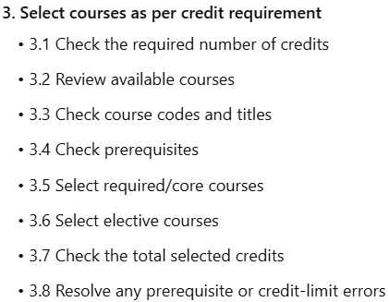
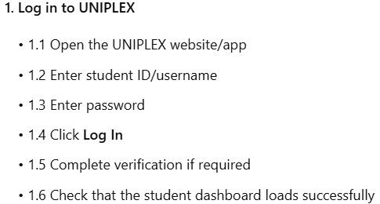

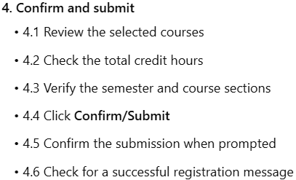
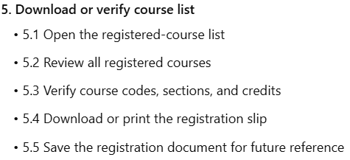
Task Decomposition (HTA) in UNIPLEX
Task: Register for courses
Hierarchical Task Analysis (HTA):
Main Goal: Register for the semester
Subtasks:
Plan: Do 1 → 2 → 3 → 4 → 5 in that order.
This breakdown helps system designers ensure the interface supports the task sequence logically and clearly.

Slide 15
Knowledge-Based Task Analysis
Task: Register for courses
To successfully register or use UNIPLEX, a user (student) needs to know:
Their credit requirements
Course prerequisites
How to navigate the UNIPLEX dashboard
Course codes and titles
Deadline for registration
Designing the system should consider this knowledge – e.g., providing tooltips, course descriptions, credit summaries.

Slide 16
Entity/Object-Based Analysis
Task: Register for courses
In UNIPLEX, key entities (objects) and actions include:
This helps map the system’s data models and understand how users interact with features.
Entity/Object | Associated Actions
Student profile | View, update, submit
Courses | Browse, select, drop
Assignments | Upload, view feedback
Results | View, download, contest
Attendance | Check, notify instructor

Slide 17
Classroom Example for Discussion
Example Task: Submitting an Assignment via UNIPLEX
Asking:
What steps do you follow?
What knowledge is required?
What objects and actions are involved?

Slide 18
Summary Table
Task Analysis Method | UNIPLEX Example
Task Decomposition | Registering courses, uploading assignments
Knowledge-Based | Knowing course codes, deadlines
Entity/Object-Based | Student, course, assignment, result

